Slide 1
Doing Data Science - Midterm Project
Michael (Branum) Stephan and Yang Zhang
For a link to the rmarkdown, see link

Slide 2
Findings
Some states have apparent large number of breweries than others, “CO” is the state with largest number of breweries.
IBU are missing in roughly half of the data collection. As we mainly analysis ABV and IBU we want to strategic on dealing with the missing values.
The scatterplot of ABV vs IBU shows positive correlation. Further investigation reflect that these two factors can be used to indicate the beer styles IPA and Ale.
KNN clustering conducted on the two Beer styles can get an accuracy >0.85, which means with ABV and IBU data, the two styles are easy to differentiated. The style IPA appear to be higher in both ABV and IBU values.
We conduct an investigation on % IPA per total craft beers in each state normalized by state population, and identified states XX, XX and XX scored highest. We recommend them as the best candidates for a trial run of Budeweiser IPA.

Slide 3
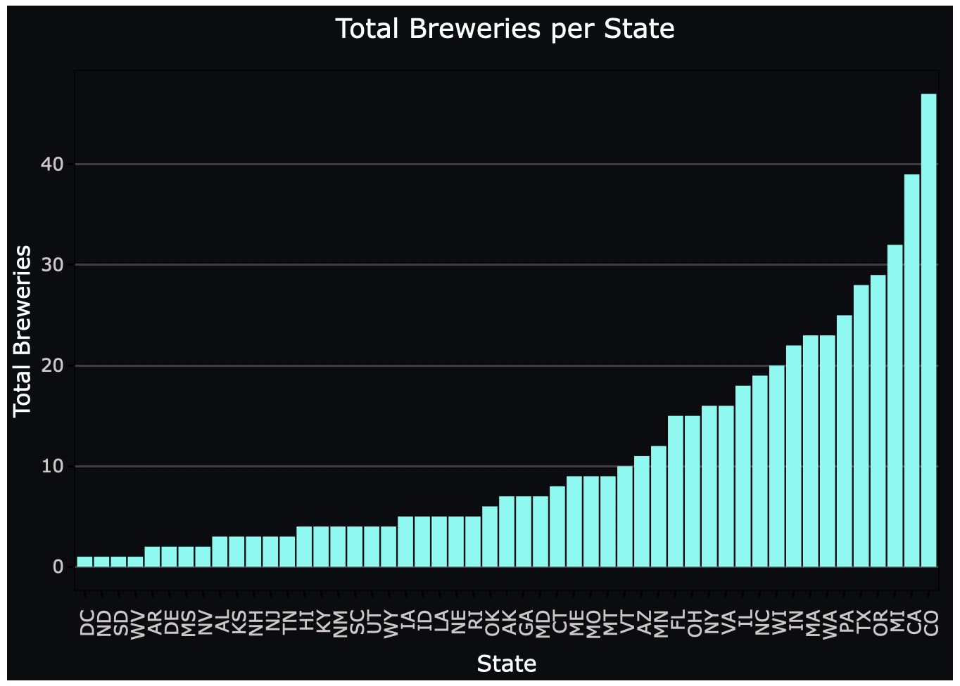
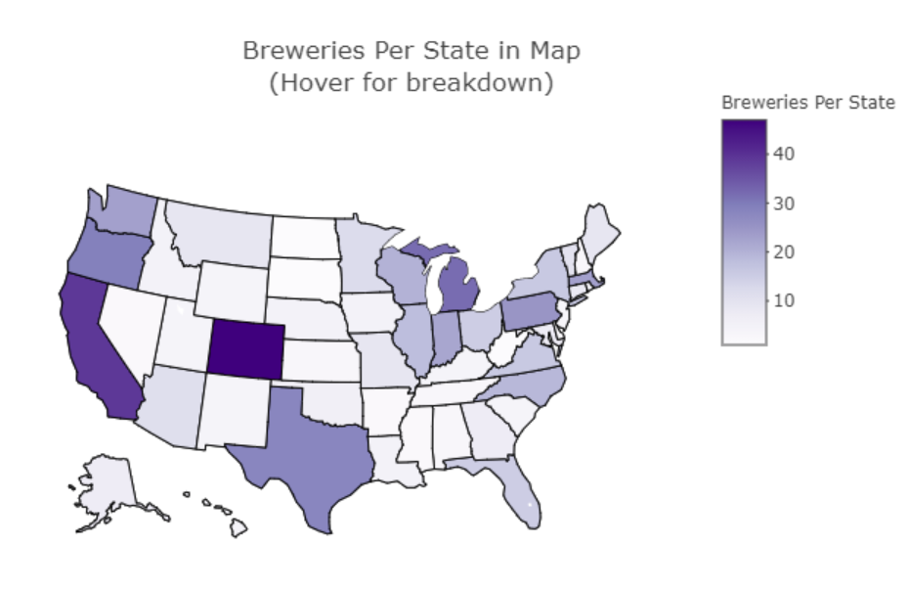
How many breweries exist per state?
Top 5 States
State | Num
CO | 47
CA | 39
MI | 32
OR | 29
TX | 28
Breweries per State by Map

Slide 4
Combining the breweries and beer data
Merge two datasets together indexed by brewery_id.
The merged dataset share the following columns:
brewery_id
beer_name
beer_id
abv
Ibu
beer_style
serving_ounces
brewery_name
City
state

Slide 5
Statistics of ”NA” values within the Dataset
Column | NAs
brewery_id | 0
beer_name | 0
beer_id | 0
abv | 62/2410
ibu | 1005/2410
beer_style | 0
serving_ounces | 0
brewery_name | 0
city | 0
state | 0
*abv_corr | 0
*Ibu_corr | 52/2410
The dataset only have missing information in ABV and IBU values, while IBU has a big portion of NAs almost half of the dataset!
As ABV and IBU are the main features we are analyzing we proceed with two tracks:
Remove all the items with NAs exist, items in total will be reduced to 1405
We think beer_style is the key variable—by each style beers are sharing common features. So we assign median value of each style to the ones with missing values in ABV and IBU. After the filling action, we have no NAs in ABU and just 52 (reduced 95%) NAs from previous dataset.

Slide 6
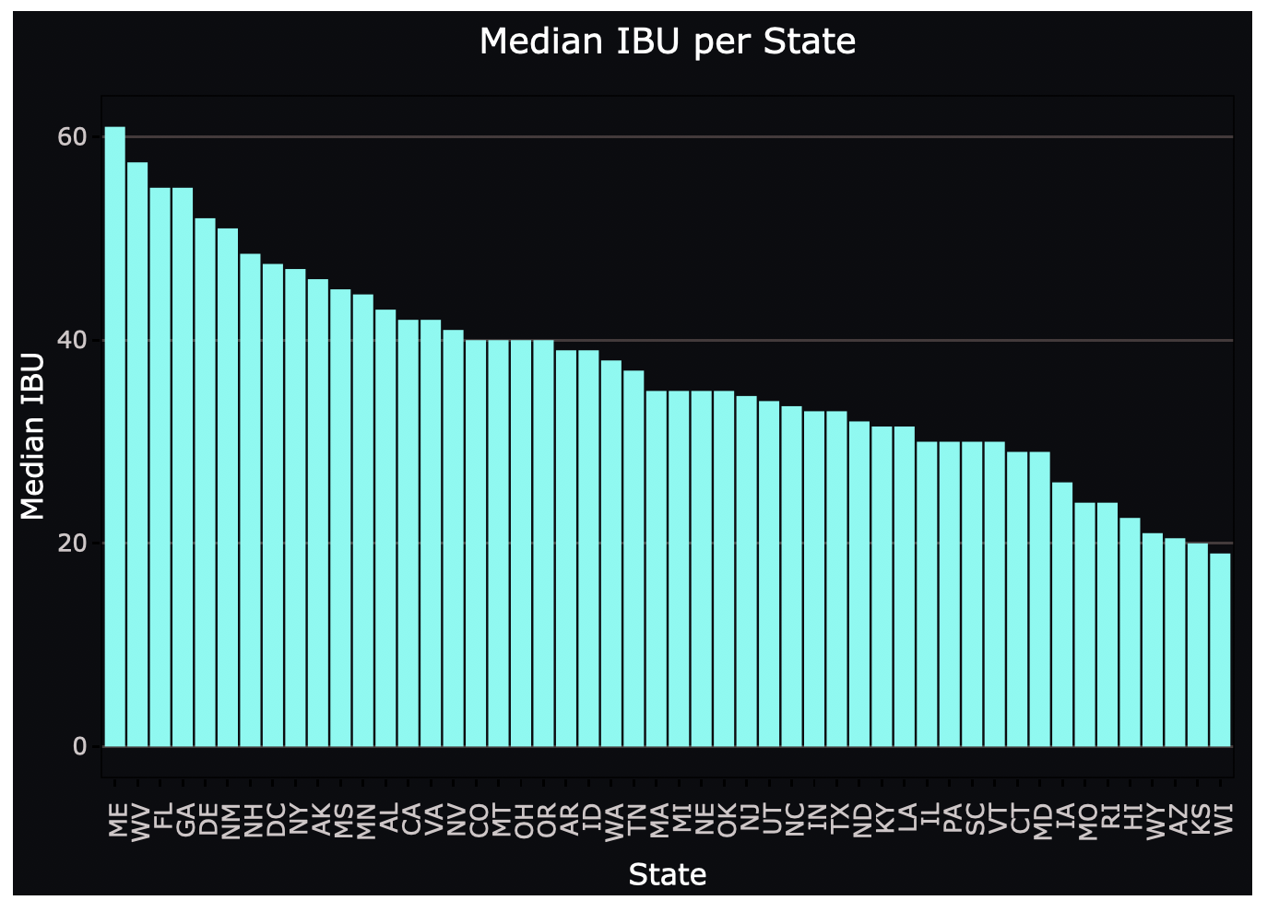
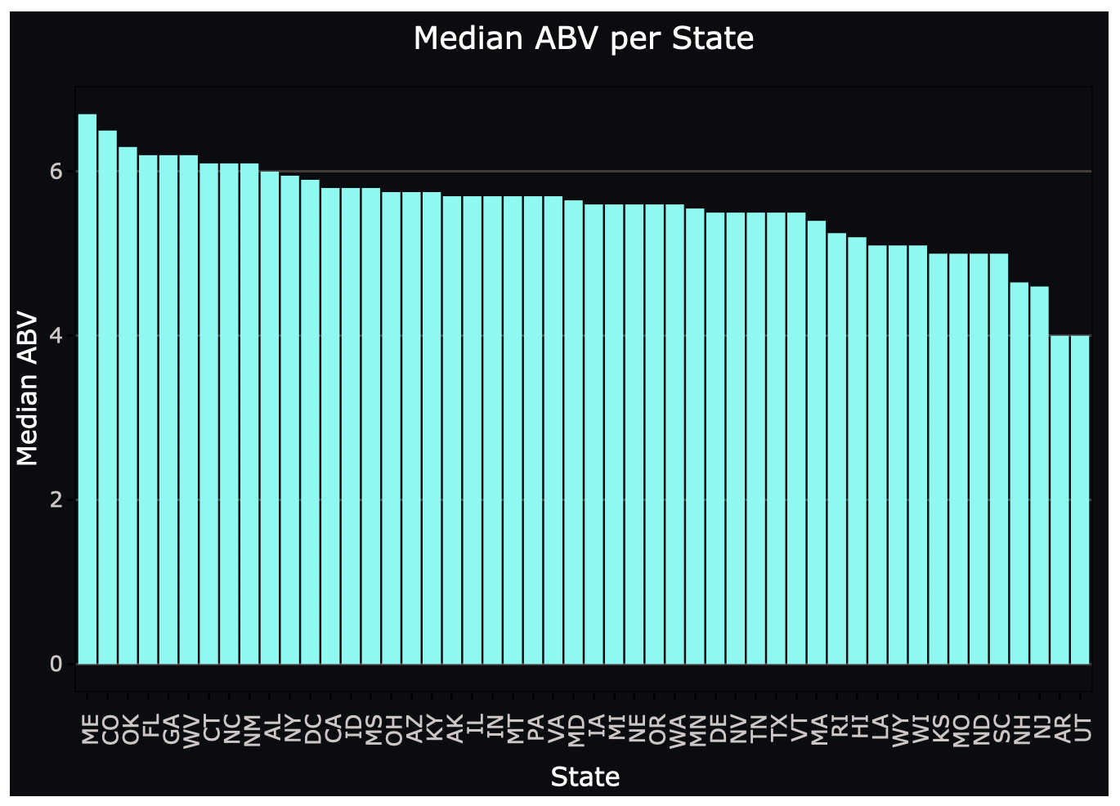
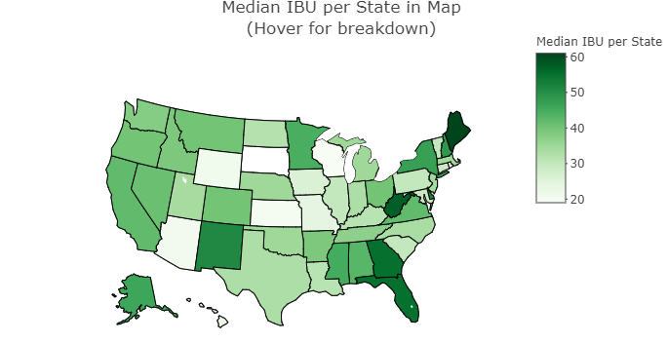
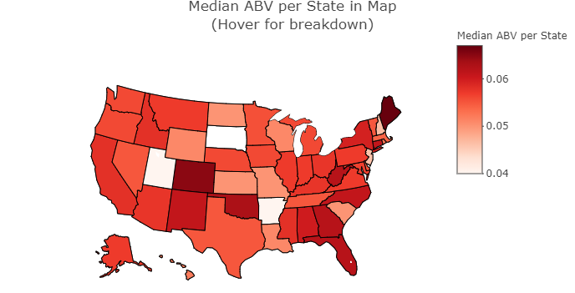
Median ABV and IBU per State
Median IBU per State by Map
Median ABV per State by Map

Slide 7
Maximum ABV and IBU per State
State | Beer_name | Max_ABV
CO | Lee Hill Series Vol. 5 | 0.128
State | Beer_name | Max_IBU
OR | Bitter B*tch | 138

Slide 8
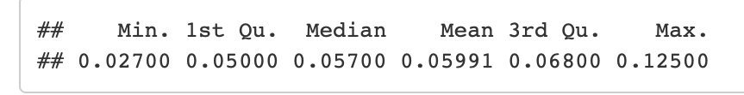
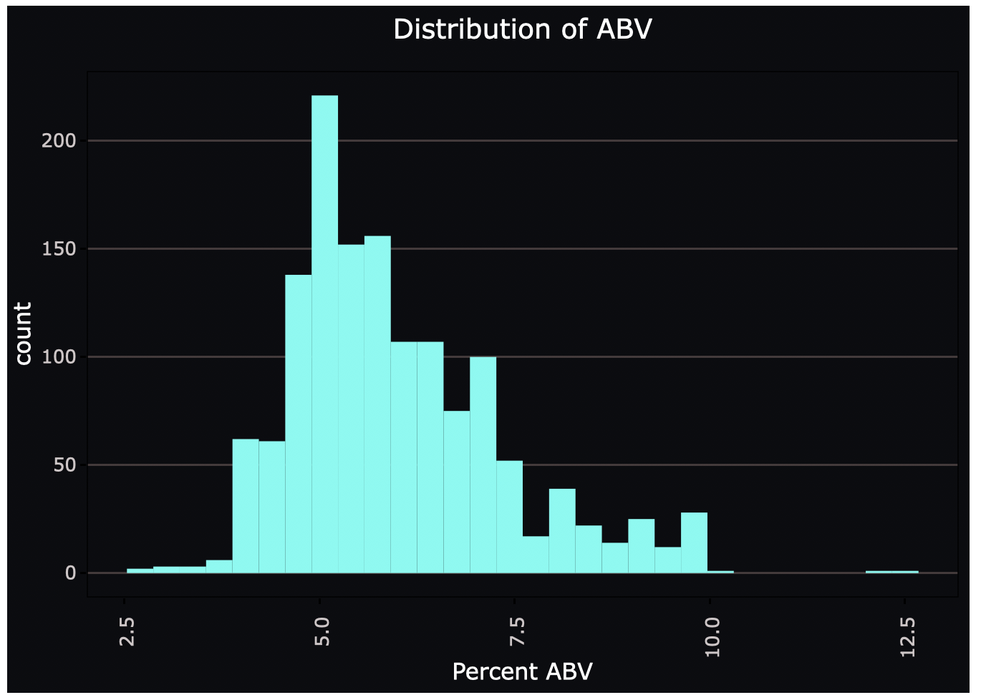
Distribution of ABV

Slide 9
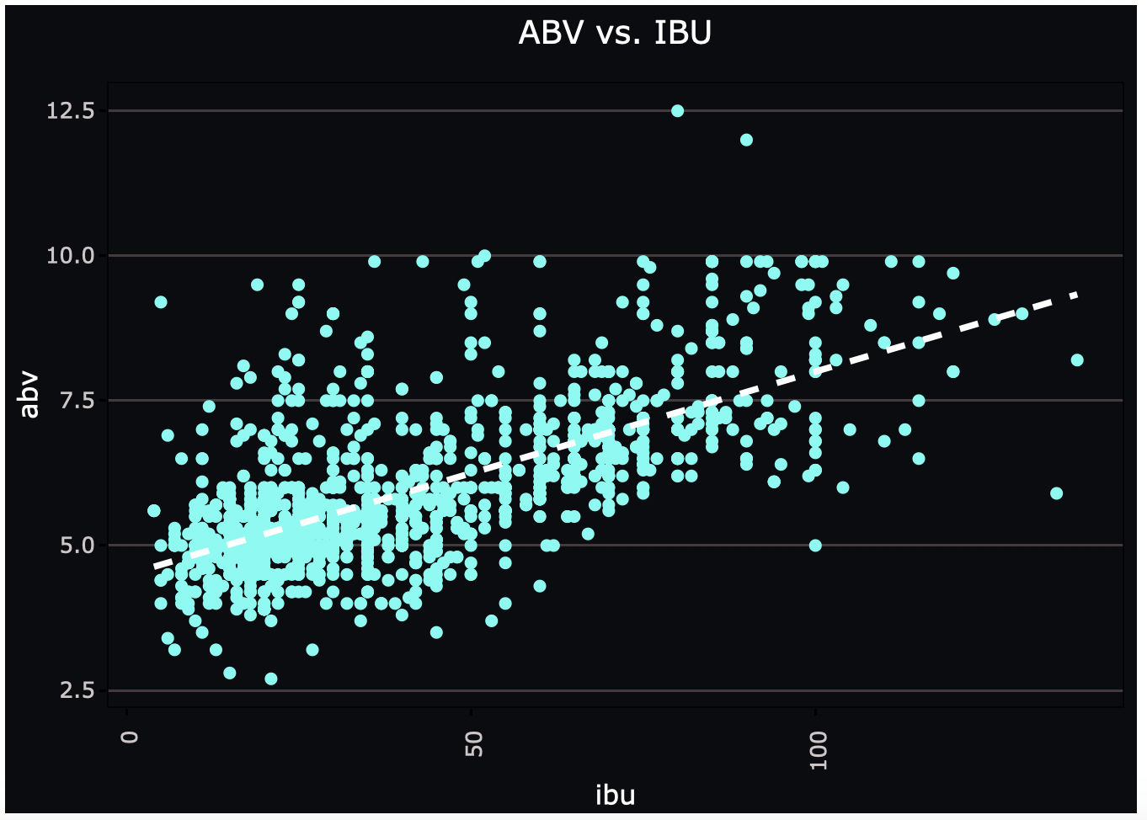
Correlation – ABV vs. IBU
It appears that there’s a linear relationship between IBU and ABV in this dataset.
With higher alcohol content the beer tend to taste more bitterness.

Slide 10
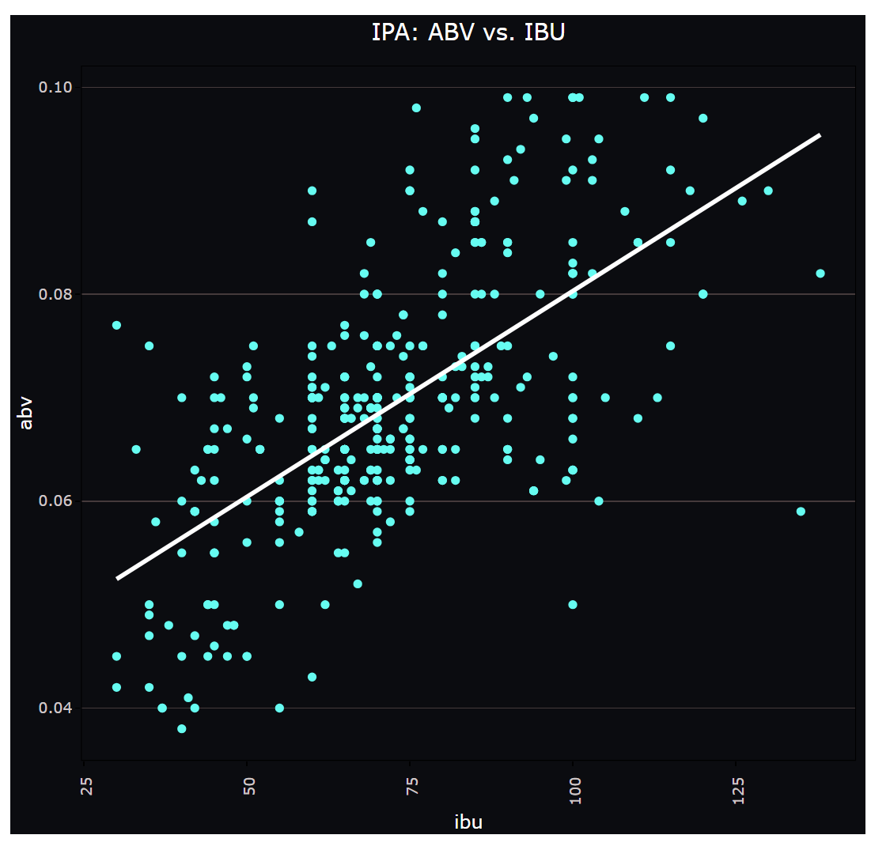
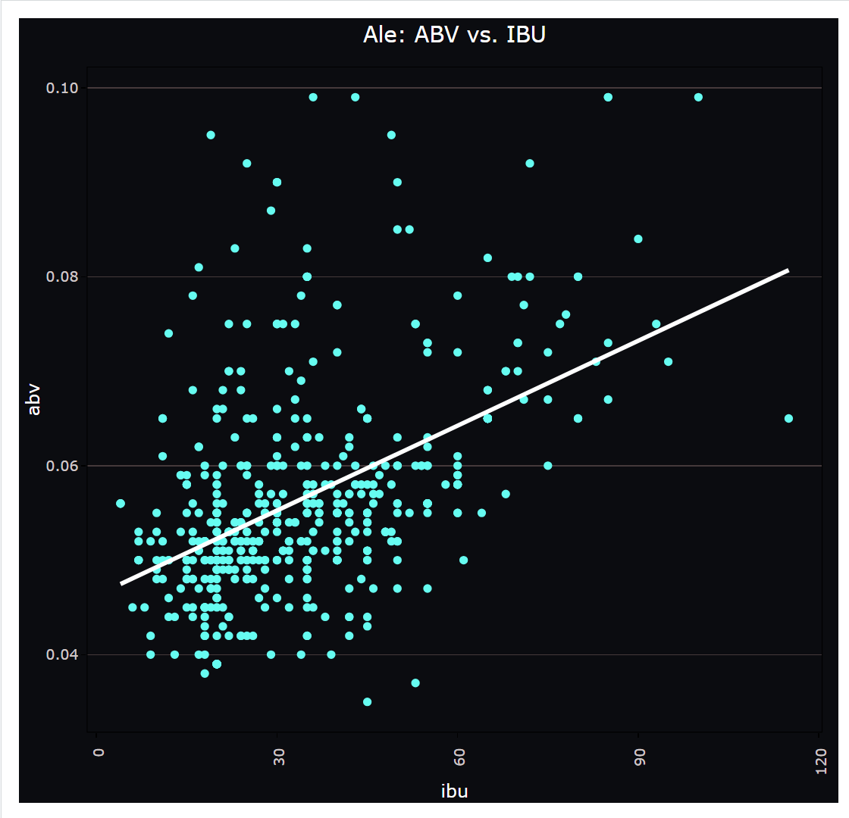
Correlation – ABV vs. IBU For Beer style：IPA and Ale
Beer style | Number
IPA | 385
Ale | 552
From visual IPA has higher ABV and IBU values and has better correlation.
The majority of Ale beers have both low but has more beers that has higher ABV but lower IBU.

Slide 11
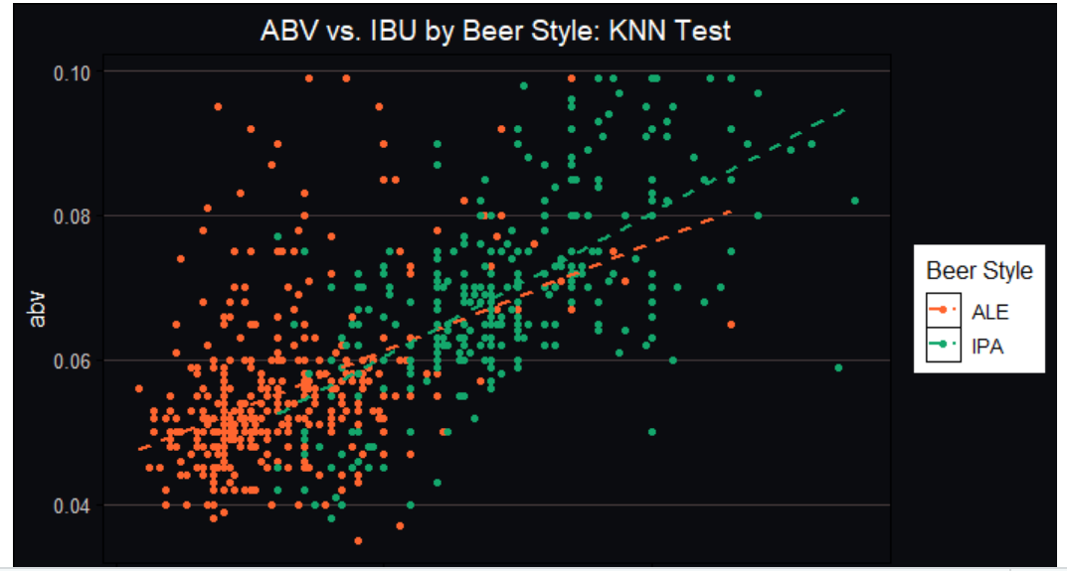
Correlation – ABV vs. IBU Plot Two Beer styles
Further visual evidences reflect that the correlation ABV vs. IBU are different with Ale and IPA styles. Majority of data points are clustered in different regions too.

Slide 12
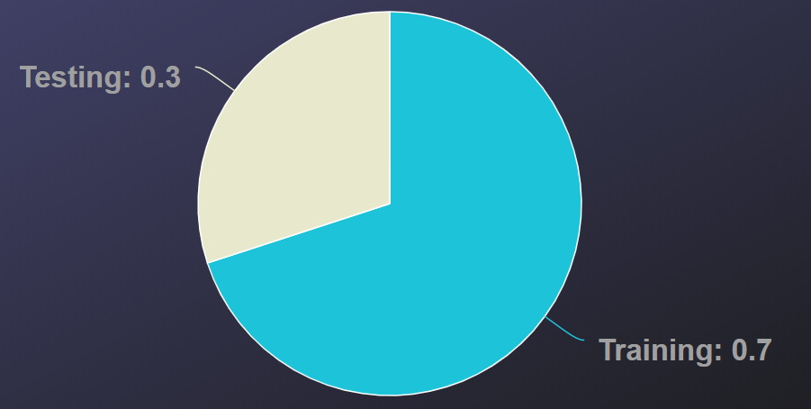
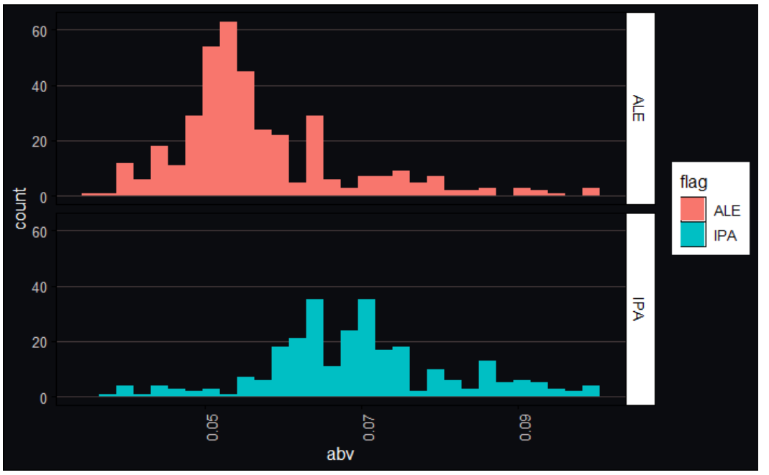
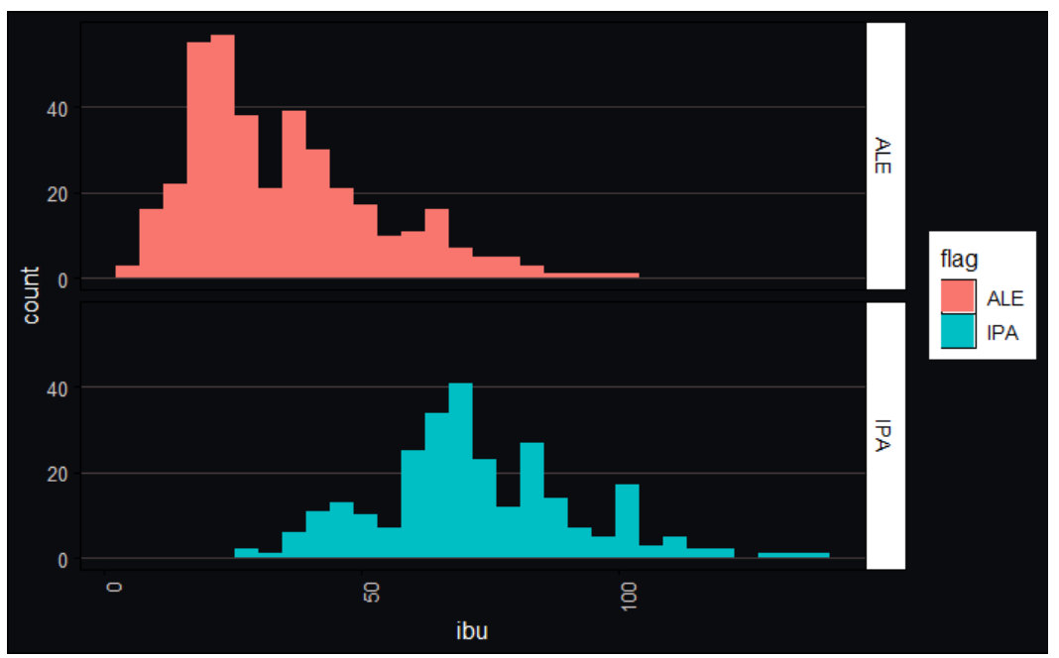
ABV vs. IBU relationship Investigation on Two Beer Styles Using KNN Clustering
Preparation for KNN clustering: Data Split into Training/Testing groups.
Observed from histograms the distributions of Ale and IPA have apparent differences. The graphs increase our confidences to successfully differentiate the two groups.
Training Data: ABV Distribution
Training Data: IBU Distribution

Slide 13
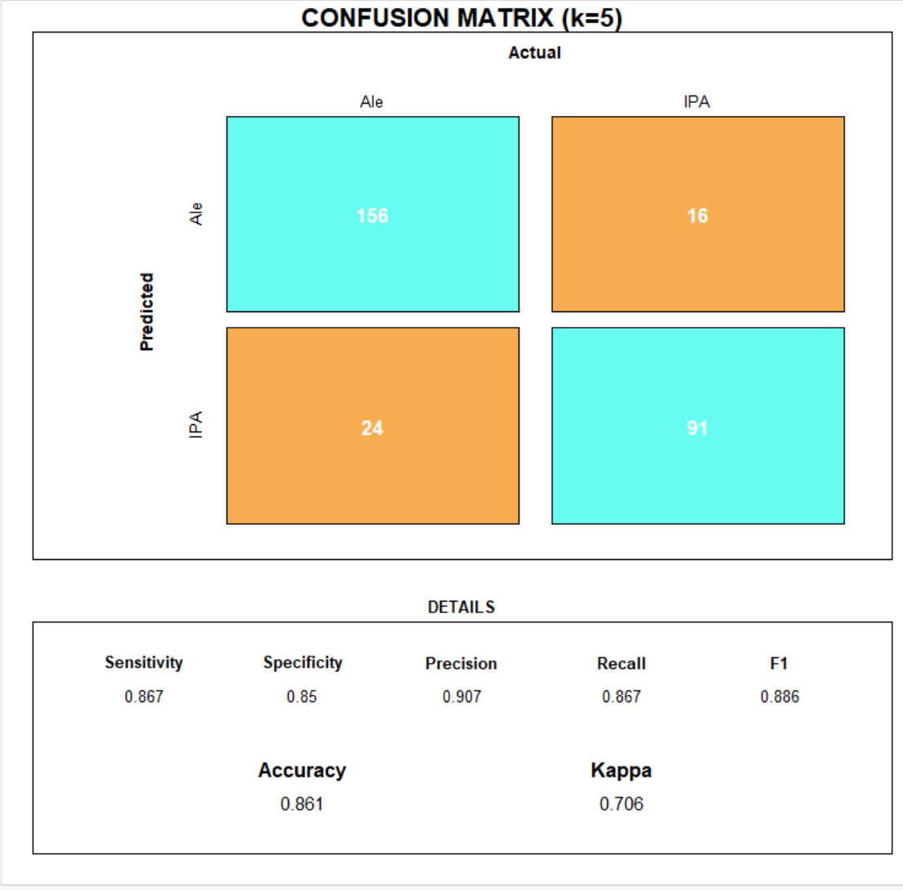
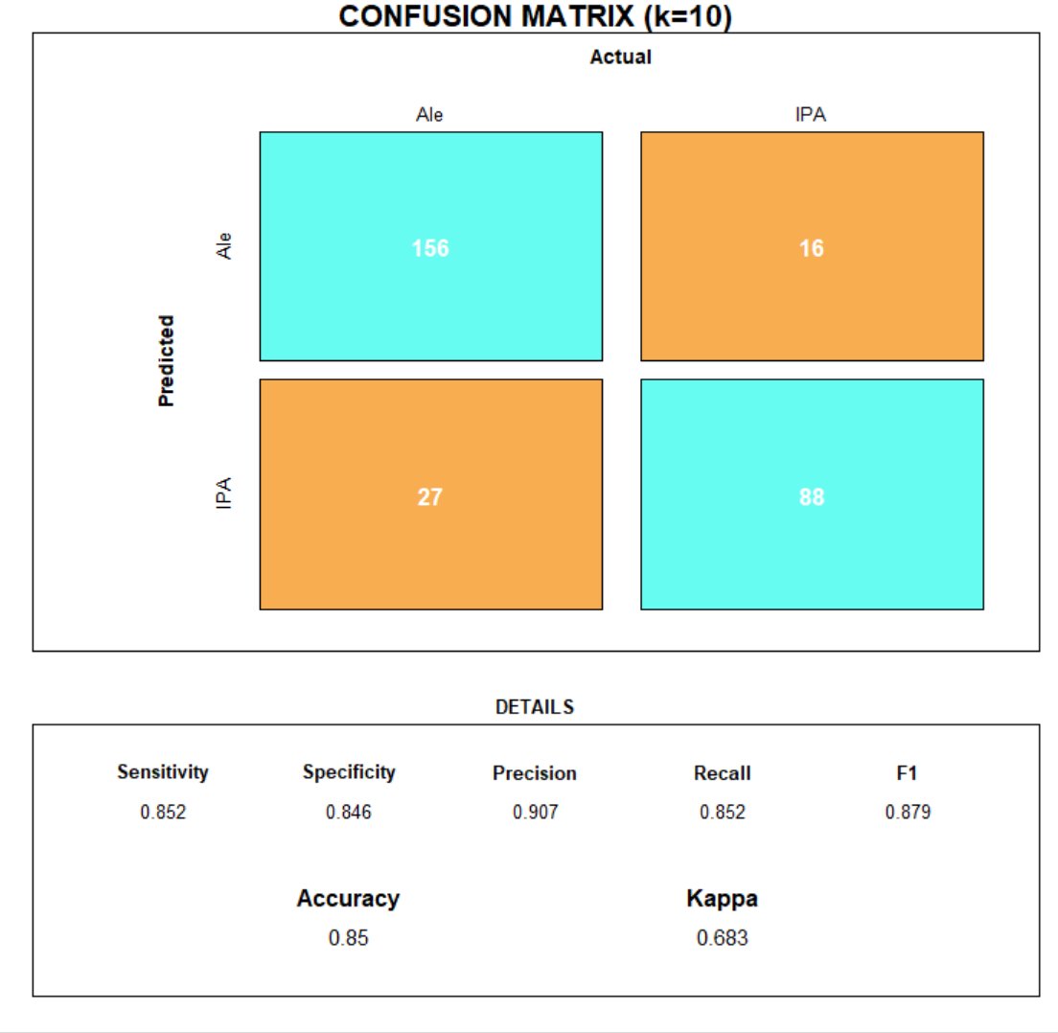
ABV vs. IBU relationship Investigation on Two Beer Styles KNN Clustering Confusion Matrix
We conduct KNN with different selection of k on the dataset and evaluate the results with confusion matrix.
Accuracy(k=5) is 0.861, Accuracy(k=10) is 0.85
Both have gain good results regarding accuracy, sensitivity and specificity. The selection of k=5 slightly better.

Slide 14
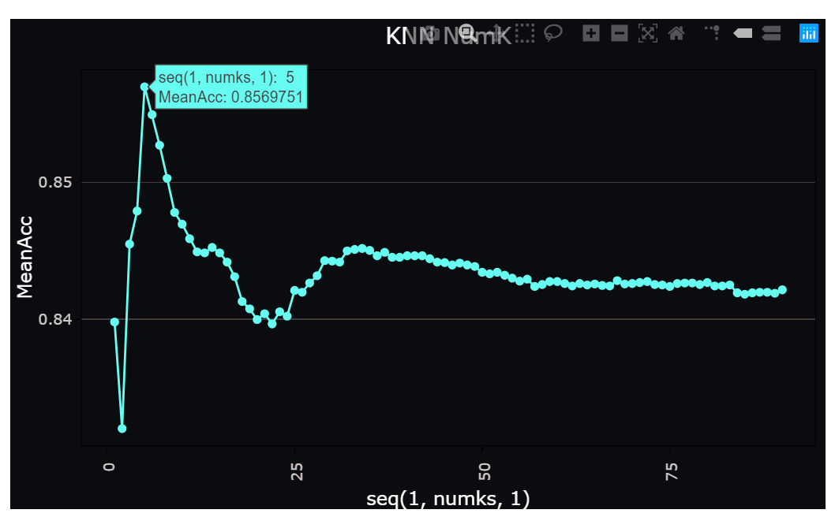
ABV vs. IBU relationship Investigation on Two Beer Styles KNN Clustering optimal K
The plot is generated from the different k-values based on the 100 different random samples.
The optimal k with this sampling group is 5.

Slide 15
ABV vs. IBU relationship Investigation on Two Beer Styles Performance Comparisons of other Methods
Method | Accuracy | Sensitivity | Specificity
KNN | 0.861 | 0.867 | 0.85
naiveBayes | 0.871 | 0.907 | 0.817
svm | 0.882 | 0.884 | 0.878
Random forest | 0.875 | 0.907 | 0.826
xgboost | 0.861 | 0.855 | 0.87
Kmeans Cluster | 0.841
The classification with different methods does not show significant differences due to high accuracy levels.
Above all methods conducted, svm and random forest shows the highest accuracy, random forest and naïveBayes show highest sensitivity, svm shows highest specificity.
By clustering the dataset with Kmeans we can also get a high accuracy which indicate further the two groups are easy to differentiate.

Slide 16
Which state to launch our next Budeweiser IPA? Count % IPA per total craft beers in each state
10 States with High %IPA
State | % | Count
DE | 50 | 1
NJ | 50 | 4
VT | 44.44 | 12
CT | 33.33 | 9
ND | 33.33 | 1
TN | 33.33 | 2
FL | 32.76 | 19
WA | 32.35 | 22
CA | 31.69 | 58
UT | 30.77 | 8
By counting the IPA style out of all styles we can get the information regional fondness of style and recognize the states with highest IPA percentages.
However some states has very few counts of styles, maybe due to less population. We need to include this factor into our consideration.

Slide 17
Which state to launch our next Budeweiser IPA? Normalized IPA by population
By considering the population factor, we further recognize the potential top 5 markets: Vermont, Colorado, Alaska, Montana and Oregon.
State | Population (in million) | IPA_per_100k
Vermont | 0.6 | 1.91
Colorado | 5.8 | 0.99
Alaska | 0.7 | 0.95
Montana | 1.1 | 0.74
Oregon | 4.2 | 0.73

Slide 18
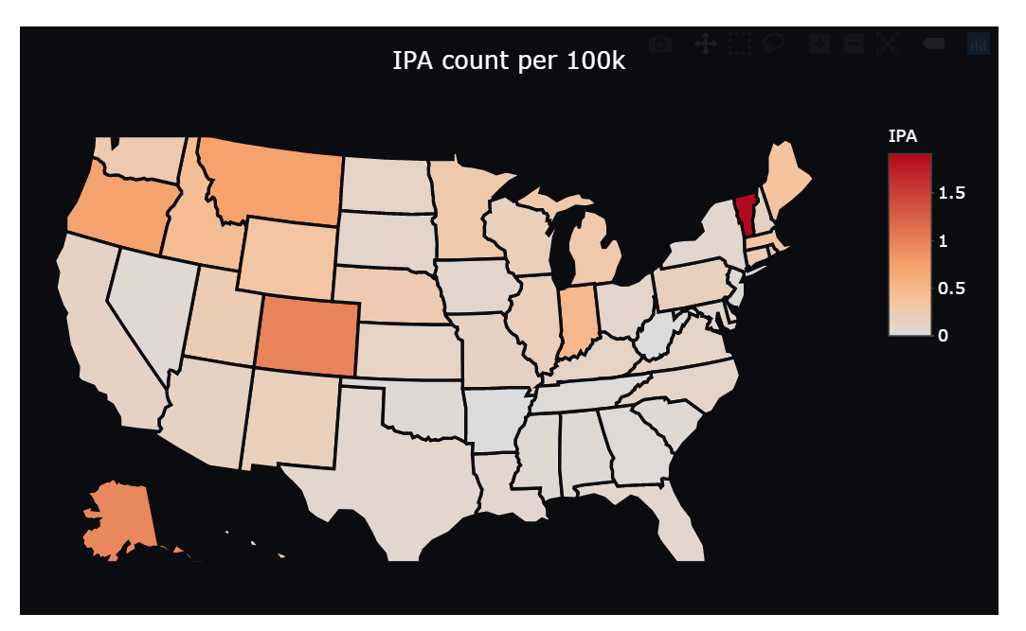
Which state to launch our next Budeweiser IPA? Where else are the markets?
The map show the locations of the states with the best potential for the IPA release.
If we were to pick a region for the release instead of isolating to only the top five consumer states, the Pacific Northwest to Colorado may be the best market to enter with hard initial avoidance in the Southeast Region.

Slide 19
Our Recommendations
By investing the IPA fondness across the nation, we recognize the potential top 5 markets: Vermont, Colorado, Alaska, Montana and Oregon.
Considering regional release preferences, we recommend the Pacific Northwest as the best market to enter, and wouldn’t recommend the Southeast Region.

